Slide 1
Exam 3
AERO 4720 Aircraft Design II

Slide 2
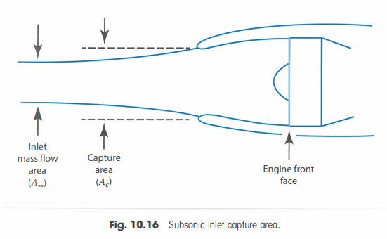
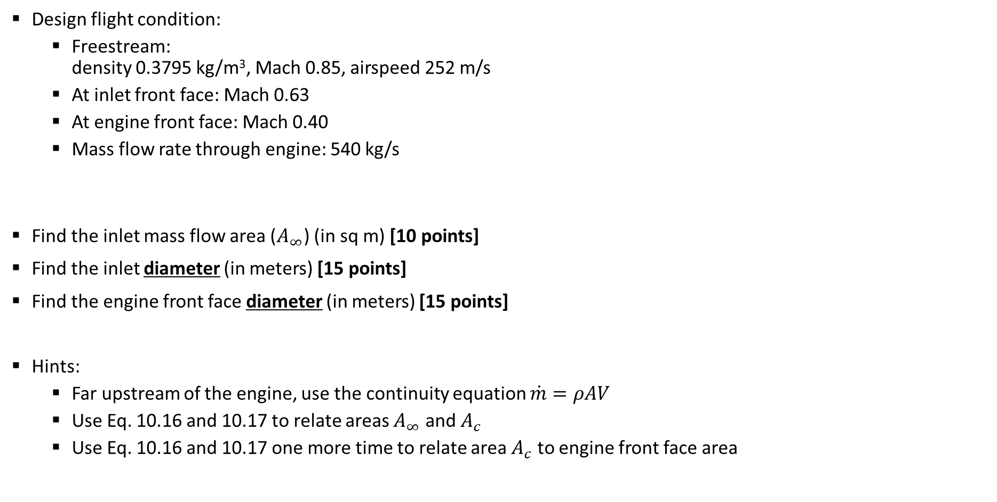
Problem 1: Subsonic Inlet Design [40 points]
Design flight condition:
Freestream: density 0.3795 kg/m³, Mach 0.85, airspeed 252 m/s
At inlet front face: Mach 0.63
At engine front face: Mach 0.40
Mass flow rate through engine: 540 kg/s
Find the inlet mass flow area ($A_{∞}$) (in sq m) [10 points]
Find the inlet diameter (in meters) [15 points]
Find the engine front face diameter (in meters) [15 points]
Hints:
Far upstream of the engine, use the continuity equation $\dot{m}=ρAV$
Use Eq. 10.16 and 10.17 to relate areas $A_{∞}$ and $A_{c}$
Use Eq. 10.16 and 10.17 one more time to relate area $A_{c}$ to engine front face area

Slide 3
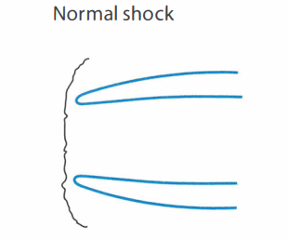

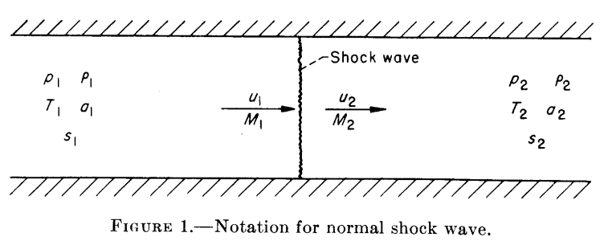
Problem 2: Supersonic Pitot Inlet Design [40 points]
Design flight condition:
Freestream: density 0.3795 kg/m³, Mach 1.40, airspeed 415 m/s
At engine front face: Mach 0.50
Mass flow rate through engine: 120 kg/s
Assuming a normal shock at the inlet, find the inlet Mach number (just downstream of the normal shock) [10 points]
Find the inlet diameter (in meters) [15 points]
Find the engine front face diameter (in meters) [15 points]
Hints: two of the three hints from Problem 1 apply here
From NACA Report 1135

Slide 4
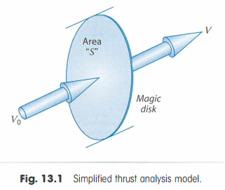

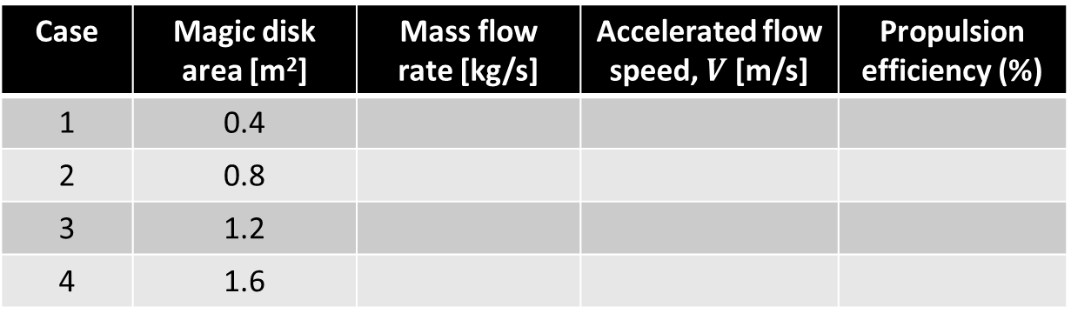
Problem 3 [20 points]
Solve this problem using the simplified “magic disk” thrust analysis model
Design flight condition:
True airspeed: $V_{0}=$ 212 m/s
Air density: 0.46 kg/m³
Thrust requirement: 20,000 N
Fill out the table for the four cases given below, where this design flight condition is achieved with four different magic disk areas. [Each case 5 points]
Case | Magic disk area [m²] | Mass flow rate [kg/s] | Accelerated flow speed, $V$ [m/s] | Propulsion efficiency (%)
1 | 0.4
2 | 0.8
3 | 1.2
4 | 1.6

